Slide 1


Data Governance @ SneakerPark
Prepared by:
Submitted on:

Slide 2
Background
SneakerPark is an online shoe reseller that allows people to buy and sell used and new shoes. Buyers can bid for shoes or buy them outright, and sellers can set a price or sell to the highest bidder.
Each buyer and seller must have an active account in order to sell, bid, or purchase sneakers using SneakerPark’s website.
SneakerPark authenticates the shoes before shipping them to the buyer, so before listing an item, the seller must ship it to SneakerPark’s warehouse. Upon receipt, SneakerPark assigns an item number to each pair of sneakers and notifies the seller that they are now free to list their item. If the item is not listed within 45 days, SneakerPark returns it to the seller and sends an invoice to the seller for the shipping cost.
If the item is found to be inauthentic or in an unacceptable condition, it is also returned back to the seller in a similar fashion.
When the item sells, the buyer’s account is credited with the purchase price minus the SneakerPark service fee and shipping fees to deliver the item to the buyer.
Currently, SneakerPark only supports sales within the United States.

Slide 3
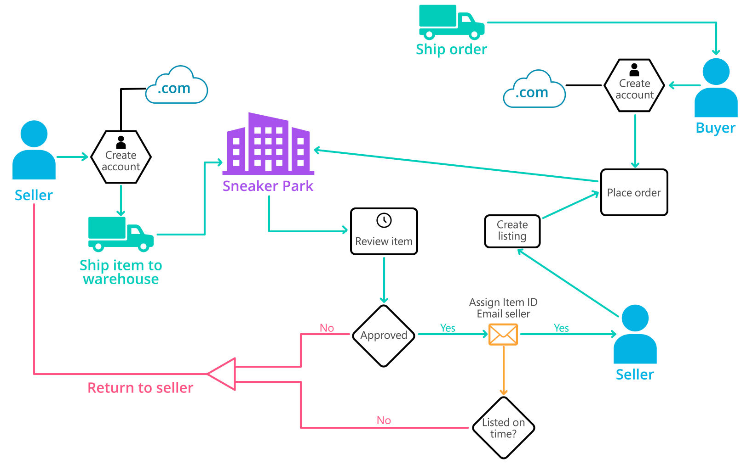
Background (cont’d)
Below you can see a diagram that will hopefully help you visualize some of SneakerPark's business processes. Keep in mind that it does not capture ALL processes and every nuance, but simply serves as another artifact to use in your project.

Slide 4
Step 1
Enterprise Data Catalog Part 1: Enterprise Data Model

Slide 5
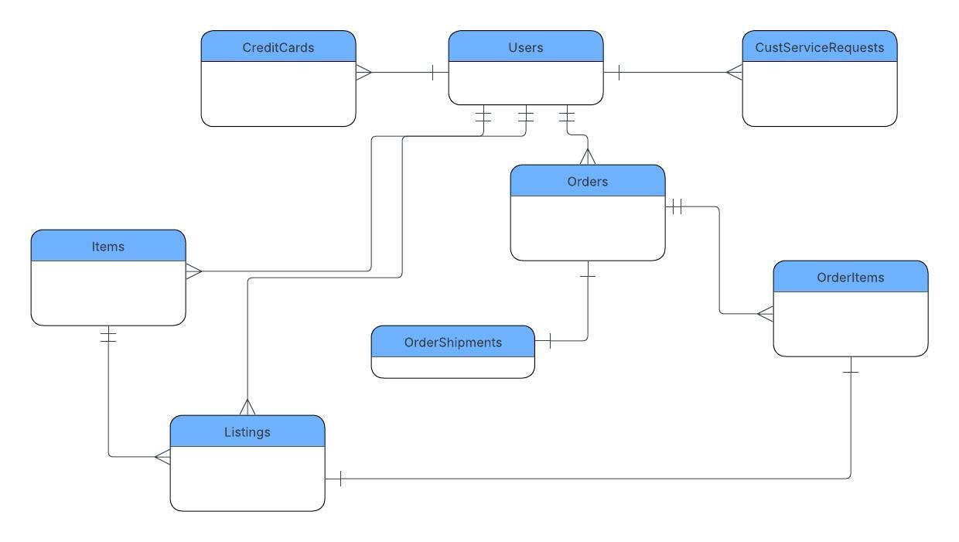
Create a conceptual data model that will provide SneakerPark with a holistic view of its data systems and help you grasp the organization's important entities and relationships, which will be instrumental as you move further in the project. You can use Lucidchart or any other diagramming tool of your choice, but please use the Crow’s Foot/IE Notation and please be sure to indicate both cardinality (the type of a relationship such as 1:N or N:N) and optionality (whether the relationship is optional or mandatory).

Slide 6
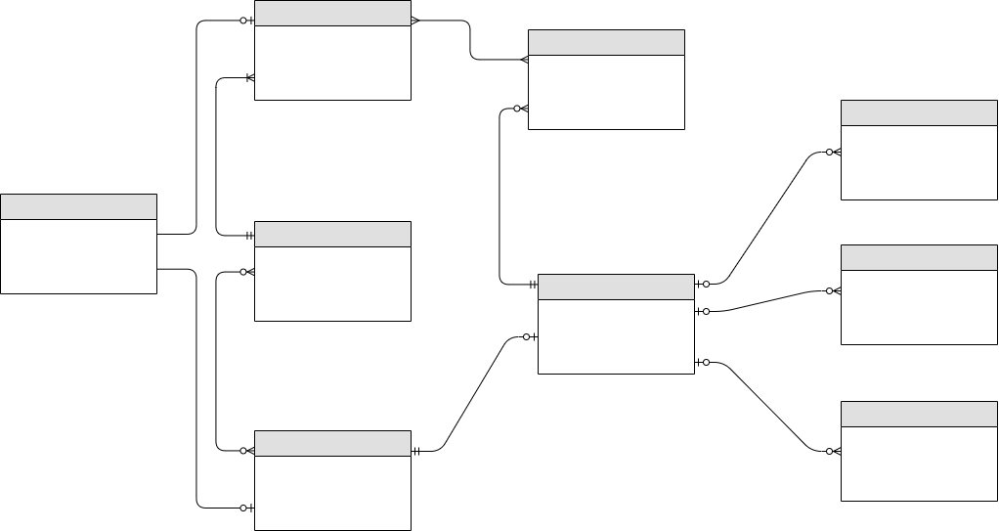
Replace the example below with your own solutions (obviously feel free to take more space):

Slide 7
Step 2
Enterprise Data Catalog Part 2: Metadata

Slide 8
Create the first version of the Metadata Catalog by documenting the metadata from all systems in the "Data Dictionary" and the “Enterprise Data Catalog” tabs of the provided Sheets template.
Please note that you are required to fill out all fields in both tabs.

Slide 9
Step 3
Data Quality
Part 1: Profiling and Cleansing

Slide 10
Profile the data to identify at least 3 data quality issues you see in the data. Also provide at least 1 data quality issue that you haven’t yet seen in the data, but can foresee occurring in the future. Based on the issues you’ve identified, come up with the data quality rule for each data quality issue, including for the one that you foresee.
Make sure you fill out all columns in the "Data Quality Issues" tab with your answers in the provided Sheets template.

Slide 11
Step 4
Data Quality
Part 2: Monitoring

Slide 12
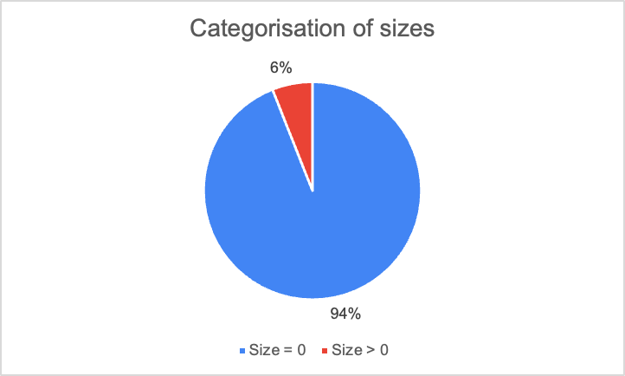
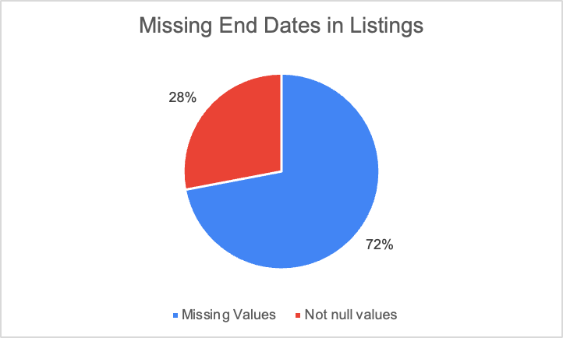
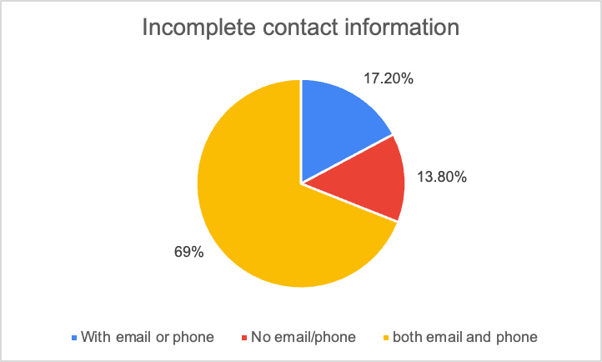
Using the metrics you've created in the last step, please create a mock-up of a data quality monitoring dashboard that will be used to monitor the data to ensure compliance with your data quality rules.
Please make sure to label your metrics clearly on your mock-up.
Replace the example dashboard below with your own. (obviously feel free to take more space).

Slide 13
Step 5
Master Data Management
Part 1: MDM Architecture

Slide 14
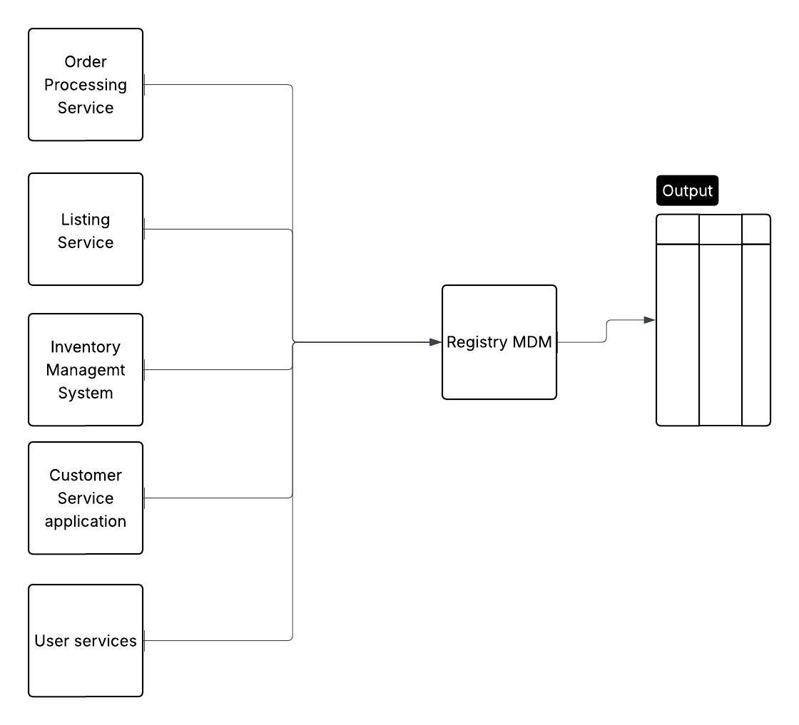
Based on what you’ve read about SneakerPark’s systems and business model, sketch out a proposed MDM implementation architecture, and write a detailed explanation of why you chose this specific approach.
Tip: Think about how your plan and its implementation might affect existing systems.
Replace example screenshot below with your own solutions (obviously feel free to take more space).
Next, please write at least a paragraph explaining your choice.

Slide 15
Explanation: I chose the the Registry MDM because it doesn’t store full master data copies. It instead creates a central reference index that links records from the 5 different systems and identifies which system holds the “best version” of each piece of information.

Slide 16
Step 6
Master Data Management
Part 2: Master Record

Slide 17
In this step, you will define a set of matching rules that will be used by the SneakerPark's MDM Hub to match item and customer entities between the company's different systems.
Please come up with 4 rules - 2 for Items and 2 for Customers and list them below.
Table | Rules
Customer | Email and OrderID. Match UserID records on the Email from Users and OrderID from CustServiceRequests.
Customer | LastName, CreditCardNumber CreditCardExpirationdate. Match UserID records on the LastName of Users and CreditCardNumber and CreditCardExpirationDate from CreditCards.
Item | Same ItemName & SellerID. Match ItemID records on the ItemName from Item & SellerID from Listings.
Item | BrandName, ArrivalDate, SellerID. Match ItemID records on the Brand Name and Arrival Date from Item and Seller ID from Listings.

Slide 18
Step 7
Data Governance:
Roles and Responsibilities

Slide 19
Write 1-2 paragraphs discussing what data governance roles and responsibilities will be necessary to oversee this new Data Management initiative. Please be sure to discuss the responsibilities in the context of at least 3 different aspects of Data Governance (such as Data Quality Management, Metadata Management, MDM, etc). Based on what you know, do SneakerPark's current employees have the necessary skills for these roles or should the company make new hires?
SneakerPark will need clear ownership and accountability for how its data is managed and shared across systems. From an MDM point of view, someone from the business (a Data Owner) should be responsible for deciding what the “official” version of key data looks like—such as products, customers, and inventory coming from order processing, listings, inventory, and customer service systems. Data Stewards would handle the day-to-day work of cleaning this data, fixing duplicates, deciding which records take priority, and making sure the data sent out from the MDM system is accurate and consistent.
For data quality, these same stewards would regularly check that incoming data is complete, correct, and up to date, while a Data Governance Lead would track overall data quality performance and step in when problems keep happening across systems. Metadata management is also important, so an Architect should document what the data means, where it comes from, and how it moves through the systems so everyone understands and trusts it.

Slide 20
Finally, security and access roles (such as platform engineers) would control who is allowed to view or change the data, especially sensitive customer information. Given these needs, SneakerPark will likely need to hire new specialists or train existing staff, because strong MDM, governance, and metadata skills are required to turn the Registry MDM into a reliable source of truth rather than just a simple data pass-through.

